Slide 1
Making Predictions: Crop Yields & Rainfall in India
Anisha, Bridget, Eileen, Matt

Slide 2
Food Insecurity in India
Very large population - 1.3 billion¹
Home to 25% of the world’s undernourished population¹
Over 50% of women and children suffer from anemia¹
Climate change is affecting rainfall, which threatens crop yields²
Could lead to increased food insecurity
Notes:
Eileen
Give background info on food scarcity information in India before posing question > gives context to why this data matters
World Food Programme. “WFP India Country Brief February 2024.” https://docs.wfp.org/api/documents/WFP-0000157424/download/?_ga=2.223841682.884694252.1713484518-10813538
11.1713484517.
Fickling, David. “India’s Food Security is Being Choked by Climate Change.” Bloomberg.com.
https://www.bloomberg.com/opinion/articles/2023-07-24/climate-change-is-choking-india-s-food-security?embedded-checkout=true. Accessed April 18, 2024.

Slide 3
Rainfall and Crop Yields in India
A large portion of agricultural production occurs in Southwest India during summer monsoon season³
Small changes in rainfall during this season have been shown to greatly affect crop yield³
A 1% change in rainfall results in a 0.34% change in annual agricultural GDP
Understanding how rainfall influences crop yields is important for the food security and overall health of the population
Notes:
Eileen
3. Bowden, C., Foster, T. & Parkes, B. Identifying links between monsoon variability and rice production in India through machine learning. Sci Rep 13, 2446 (2023). https://doi.org/10.1038/s41598-023-27752-8

Slide 4
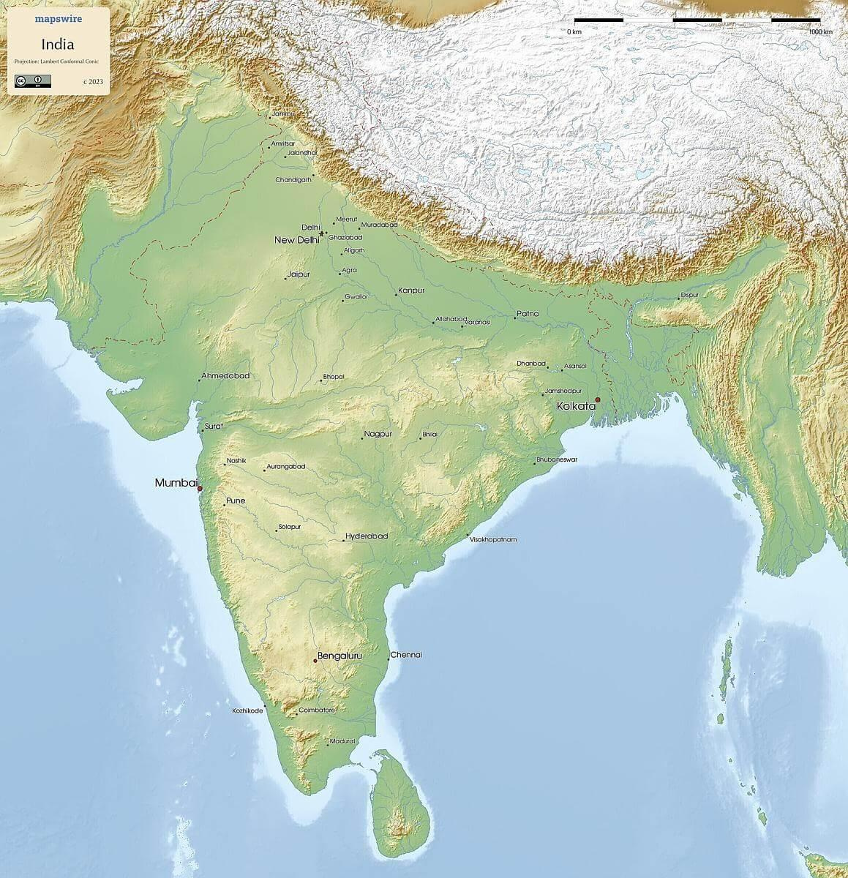
How does rainfall affect crop yields in India?
Two data sets:
Crop yields by state
Rainfall monthly by state
Duration: 1997-2017
Four key crops:
Maize
Moong (Green Gram)
Rice
Urad
Notes:
Eileen
Image: https://mapswire.com/maps/india/

Slide 5
Data Cleaning & SQL Table Join
Data cleaning
Rain data was based on yearly rainfall
Crop data on seasonal yields for harvest
Both data sets aggregated on year
Matched districts to states
Joined data on state and year using inner join
Notes:
Bridget

Slide 6
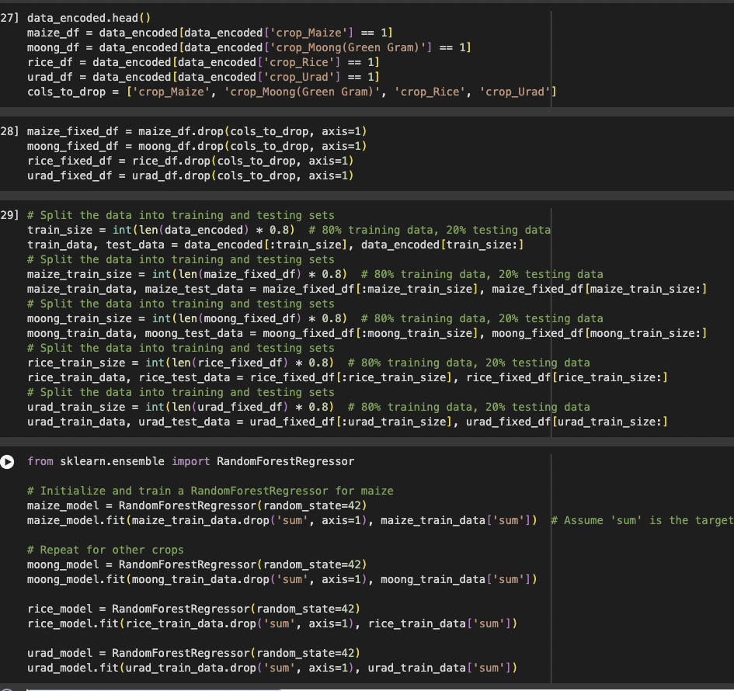
Machine Learning Methods
Split data into training and test sets for each crop
Added lag variables to ensure no overlap between training and test set
Made separate sets based on the different crops
Compiled and trained a neural network model
Performed RandomForest linear regression
Created several visualizations to represent our analyses
Notes:
Matt
Mention trying ARIMA model, why that didn’t work
Mention how neural network was giving an awful rt mse and accuracy score
Random forest performed better
Some great visualizations

Slide 7
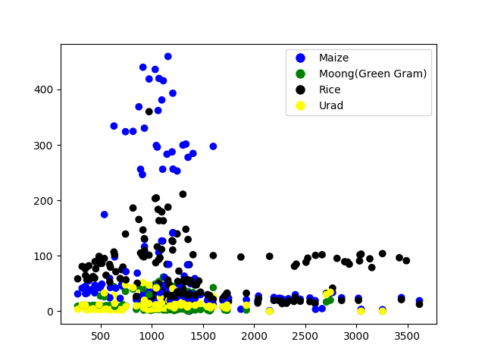
Crop Yields vs. Rainfall by State
Crop Yields vs. Rainfall by State
All crops do best in rainfall ranging from 500 to 1700 cm annually
In too little or too much rain, crop yield decreases
This could be related to heavy monsoon seasons that kill crops
Crop Yields
Annual Rainfall
Notes:
Matt

Slide 8
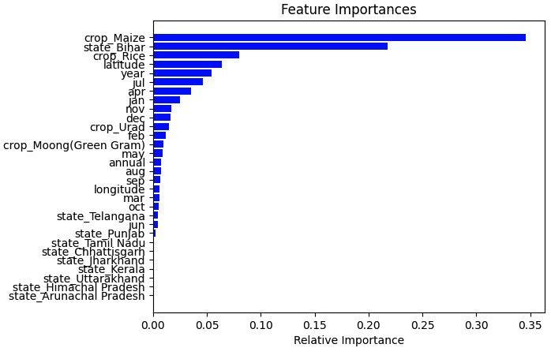
Feature Importances
Why the 4 selected crops were chosen
Notes:
Matt

Slide 9
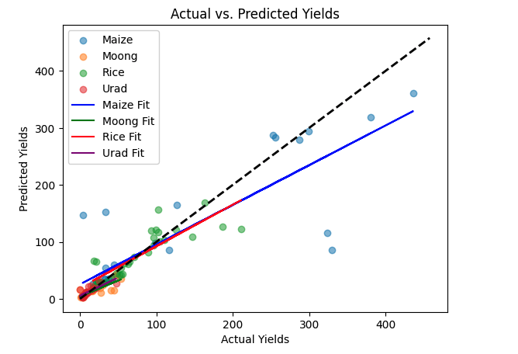
Actual vs. Predicted Yields
Black line shows 100% accuracy of prediction
Most crops fell along the line, but accuracy of the model is not perfect
Notes:
Anisha
- Employed Random Forest models due to their robustness in handling complex datasets with multiple features.
- Models excel at capturing non-linear relationships and interactions, ideal for the multifaceted nature of agricultural datasets.
- Visual representation comparing model predictions to actual crop yields.
- Focus on four significant crops: maize, moong, rice, and urad.
- Line of Perfect Prediction:
o Black dashed line represents perfect prediction accuracy.
o Ideal scenario: all predictions align perfectly with this line.
- Most predictions are close to the line of perfect prediction, indicating reasonable accuracy.
- Scatter points around the line show that the model’s accuracy is not perfect, especially at higher yield values.
- Despite challenges, the model is proficient in predicting yields for diverse crop types.
o Suggestions for improvement: incorporating more data sources and using advanced algorithms to enhance accuracy.

Slide 10
Results Considerations
Accuracy can be misleading - the cost of different predictors may vary, and the current model does not account for this
For example, rainfall is the only predictor being looked at, when we know several factors influence crop growth
We know the data was not overfit - AKA no overlap between training and test data
Some models do not perform well with unseen data
Knowing the nature of the data, the model did a good job predicting crop yields based on rainfall
A different type of linear regression may be able to better handle the data
Notes:
Bridget

Slide 11
Conclusions and Future Questions
Rainfall does affect crop yield
Too little rainfall, as well as too much will greatly influence the yield of maize and rice
Random Forest features and scatter plots of cleaned cdata can help narrow the focus of your question
Machine learning models are difficult to train with real world data
Notes:
Anisha
As we conclude our analysis, it's clear that rainfall indeed has a significant impact on crop yields - affecting not just the overall volume but also the variability of agricultural output.Our models have captured this fundamental relationship, offering insights into how both extremes of rainfall, be it scarcity or surplus, critically influence yields, particularly for staple crops such as maize and rice.
Furthermore, our work with Random Forest models has shed light on the power of machine learning in agricultural data science.By leveraging feature importance rankings and creating scatter plots for our cleaned data, we were able to refine our research focus and identify the most influential factors affecting crop yield.
However, real-world data presents unique challenges. It's often untidy and unpredictable, reflecting the chaotic nature of the environments from which it is sourced.

Slide 12
Sources
Bowden, C., Foster, T. & Parkes, B. Identifying links between monsoon variability and rice production in India through
machine learning. Sci Rep 13, 2446 (2023). https://doi.org/10.1038/s41598-023-27752-8.
Fickling, David. “India’s Food Security is Being Choked by Climate Change.” Bloomberg.com.
https://www.bloomberg.com/opinion/articles/2023-07-24/climate-change-is-choking-india-s-food-security?embedded-che
ckout=true. Accessed April 18, 2024.
Mapswire. “Physical Map of India. Projection: Lambert Conformal Conic.” https://mapswire.com/maps/india/.
Pyatakov, Oleg. Data collected from Ministry of Agriculture and Farmers Welfare of India (2023). “India Agriculture Crop Production”
[dataset]. https://www.kaggle.com/datasets/pyatakov/india-agriculture-crop-production.
Saran, Sai. (2021). “Rainfall Data from 1901 to 2017” [dataset].
https://www.kaggle.com/datasets/saisaran2/rainfall-data-from-1901-to-2017-for-india/data.
World Food Programme. “India.” https://www.wfp.org/countries/india.
World Food Programme. “WFP India Country Brief February 2024.”
https://docs.wfp.org/api/documents/WFP-0000157424/download/?_ga=2.223841682.884694252.1713484518-10813538
11.1713484517.

